Slide 1
Existence of 3-factors in Star-free Graphs with High Connectivity
Shuto Nishida
(Tokyo University of Science)
Nov. 26, 2018
Guangzhou discrete mathematics seminar
Sun Yat-sen Univ.

Slide 2
Outline
Definitions and Notations
Regular factors in star-free graphs
  1-factor, 2-factor and 4-factor
3-factors in star-free graphs
  main results and outline of its proof
Future works

Slide 3
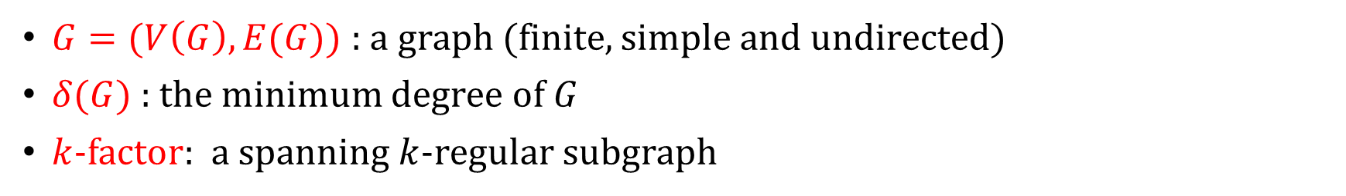
Definitions and Notations
$G=(V\left(G\right), E(G))$ : a graph (finite, simple and undirected)
$δ(G)$ : the minimum degree of $G$
$k$-factor: a spanning $k$-regular subgraph

Slide 4
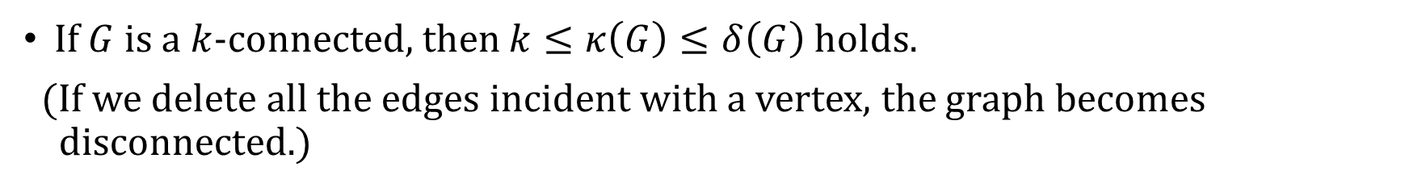
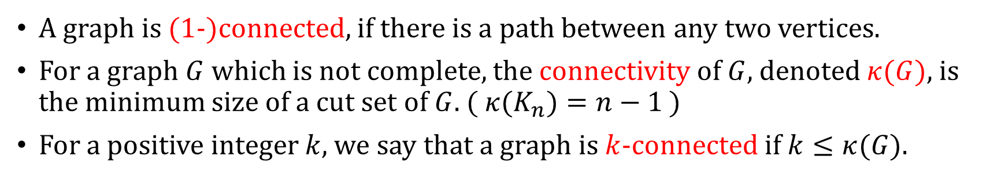
Definitions and Notations
A graph is (1-)connected, if there is a path between any two vertices.
For a graph $G$ which is not complete, the connectivity of $G$, denoted $κ(G)$, is the minimum size of a cut set of $G$. (${ κ(K}_{n})=n−1$ )
For a positive integer $k$, we say that a graph is $k$-connected if $k≤κ(G)$.
If $G$ is a $k$-connected, then $k≤κ\left(G\right)≤δ\left(G\right)$ holds.
(If we delete all the edges incident with a vertex, the graph becomes
disconnected.)

Slide 5
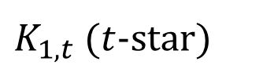


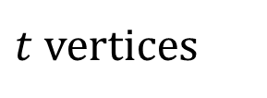

Definitions and Notations
We say that $G$ is a $K_{1,t}$-free graph if $G$ does not contain $K_{1,t}$ as an induced subgraph.
$$K_{1,3}$$
・・・
$t$ vertices
Not $K_{1,4}$
$K_{1,t}$ ($t$-star)
$$G_{2}$$
$G_{2}$ contains $K_{1,3}$ as an induced subgraph.
$G_{2}$ does not contain $K_{1,4}$ as an induced subgraph→ $G_{2}$ is a $K_{1,4}$-free graph.

Slide 6
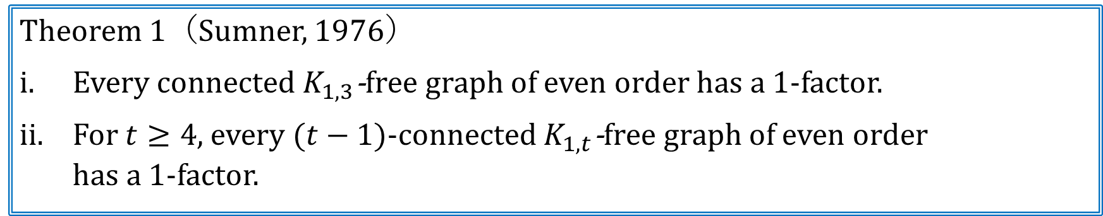
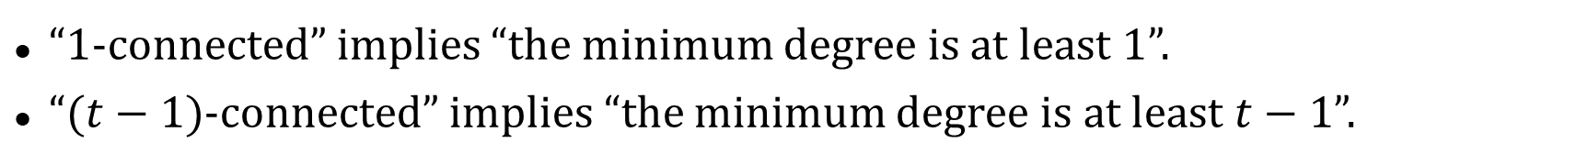
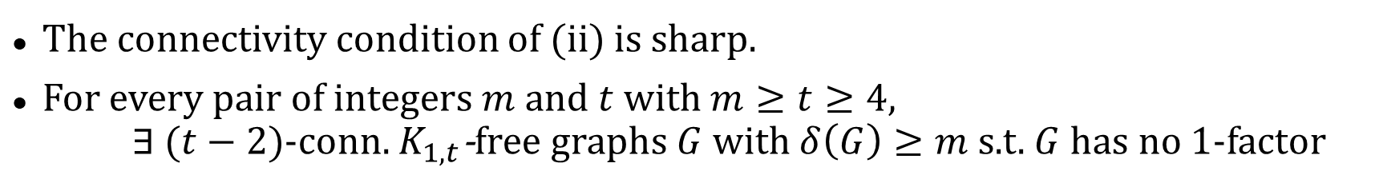
1-factors in $K_{1,t}$-free graphs
Theorem 1（Sumner, 1976）
Every connected $K_{1,3}$-free graph of even order has a 1-factor.
For $t≥4$, every $(t−1)$-connected $K_{1,t}$-free graph of even order
has a 1-factor.
The connectivity condition of (ii) is sharp.
For every pair of integers $m$ and $t$ with $m≥t≥4$,
$∃$ $(t−2)$-conn. $K_{1,t}$-free graphs $G$ with $δ\left(G\right)≥m$ s.t. $G$ has no 1-factor
“1-connected” implies “the minimum degree is at least 1”.
“$(t−1)$-connected” implies “the minimum degree is at least $t−1$”.
There is no gap between connectivity and minimum degree conditions
which we have to assume.

Slide 7
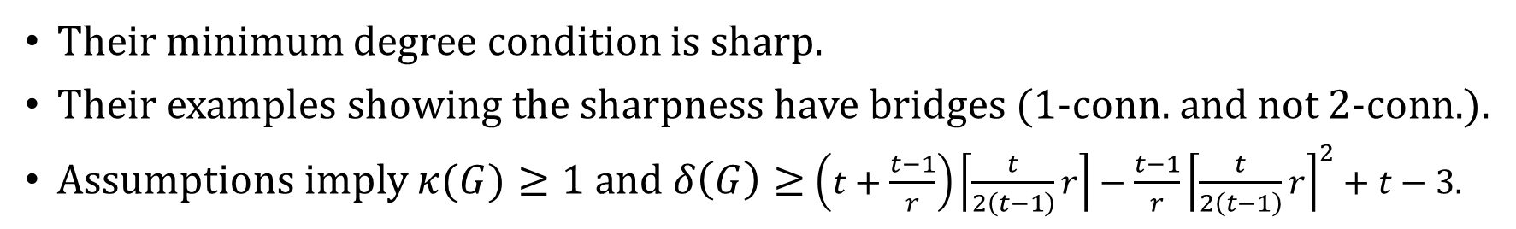
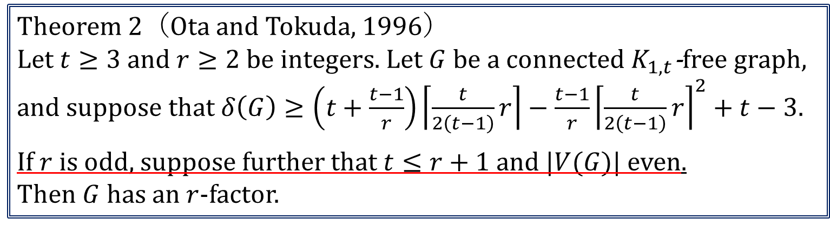
$r(≥2)$-factors in $K_{1,t}$-free graphs
Theorem 2（Ota and Tokuda, 1996）
Let $t≥3$and $r≥2$ be integers. Let $G$ be a connected $K_{1,t}$-free graph,
and suppose that $δ\left(G\right)≥\left(t+\frac{t−1}{r}\right)\left\lceil \frac{t}{2\left(t−1\right)}r\right\rceil −\frac{t−1}{r}{\left\lceil \frac{t}{2\left(t−1\right)}r\right\rceil }^{2}+t−3.$
If $r$ is odd, suppose further that $t≤r+1$ and |$V(G)$| even.
Then $G$ has an $r$-factor.
Their minimum degree condition is sharp.
Their examples showing the sharpness have bridges (1-conn. and not 2-conn.).
Assumptions imply $κ(G)≥1$ and $δ\left(G\right)≥$ $\left(t+\frac{t−1}{r}\right)\left\lceil \frac{t}{2\left(t−1\right)}r\right\rceil −\frac{t−1}{r}{\left\lceil \frac{t}{2\left(t−1\right)}r\right\rceil }^{2}+t−3$.
Can we relax the minimum degree condition by assuming larger connectivity?

Slide 8
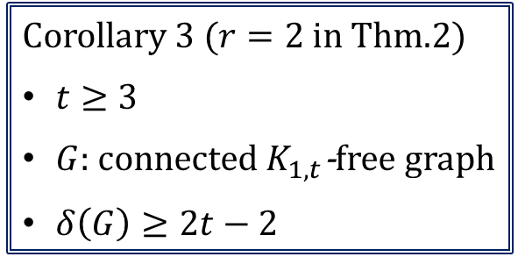
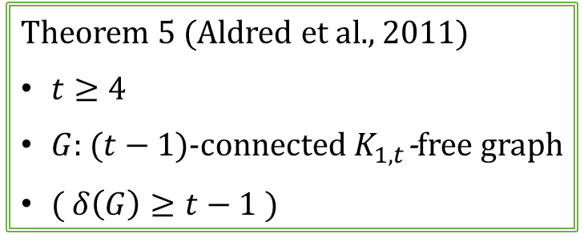
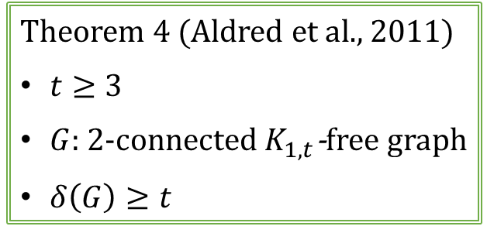
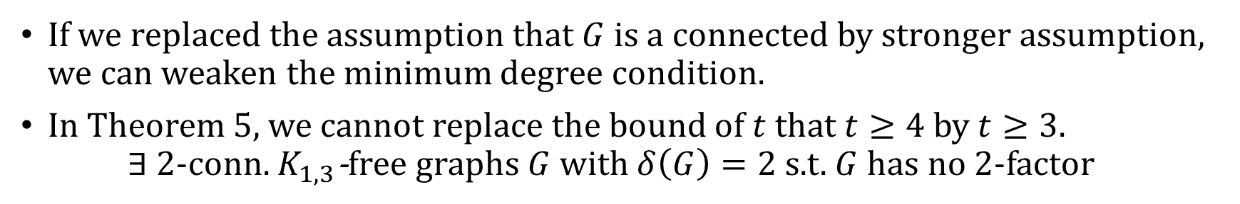
Sufficient conditions to have a 2-factor in $K_{1,t}$-free graphs
Corollary 3 ($r=2$ in Thm.2)
$t≥3$
$G$: connected $K_{1,t}$-free graph
$δ\left(G\right)≥2t−2$
Theorem 4 (Aldred et al., 2011)
$t≥3$
$G$: 2-connected $K_{1,t}$-free graph
$δ\left(G\right)≥t$
Theorem 5 (Aldred et al., 2011)
$t≥4$
$G$: ($t−1$)-connected $K_{1,t}$-free graph
( $δ\left(G\right)≥t−1$ )
(※ All minimum degree conditions are sharp)
If we replaced the assumption that $G$ is a connected by stronger assumption, we can weaken the minimum degree condition.
In Theorem 5, we cannot replace the bound of $t$ that $t≥4$ by $t≥3$.
$∃$ $2$-conn. $K_{1,3}$-free graphs $G$ with $δ\left(G\right)=2$ s.t. $G$ has no 2-factor

Slide 9
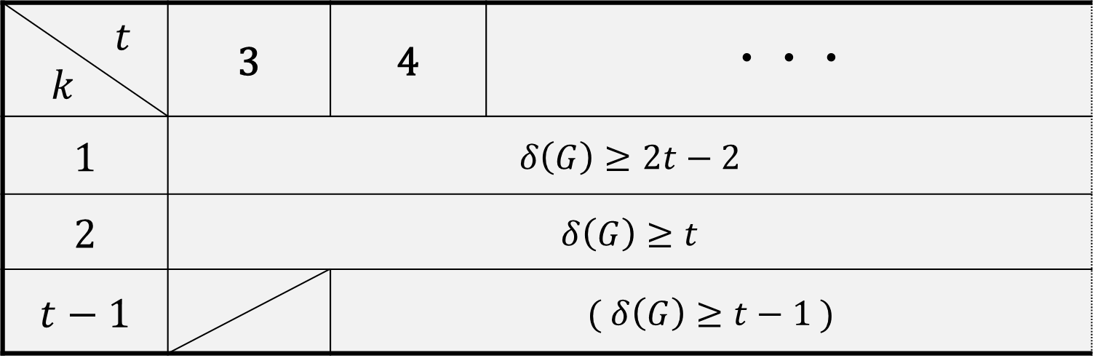

Minimum degree conditions to have a 2-factor in $k$-connected $K_{1,t}$-free graphs
$t$ $k$ | 3 | 4 | ・・・
1 | $$δ\left(G\right)≥2t−2$$
2 | $$δ\left(G\right)≥t$$
$$t−1$$ |  | ( $δ\left(G\right)≥t−1$ )
2-factor’s case has been completed.
At first, there is a gap between connectivity and minimum degree condition which we have to assume.
We can relax the minimum degree condition by assuming larger connectivity.
In the end there is no gap.

Slide 10
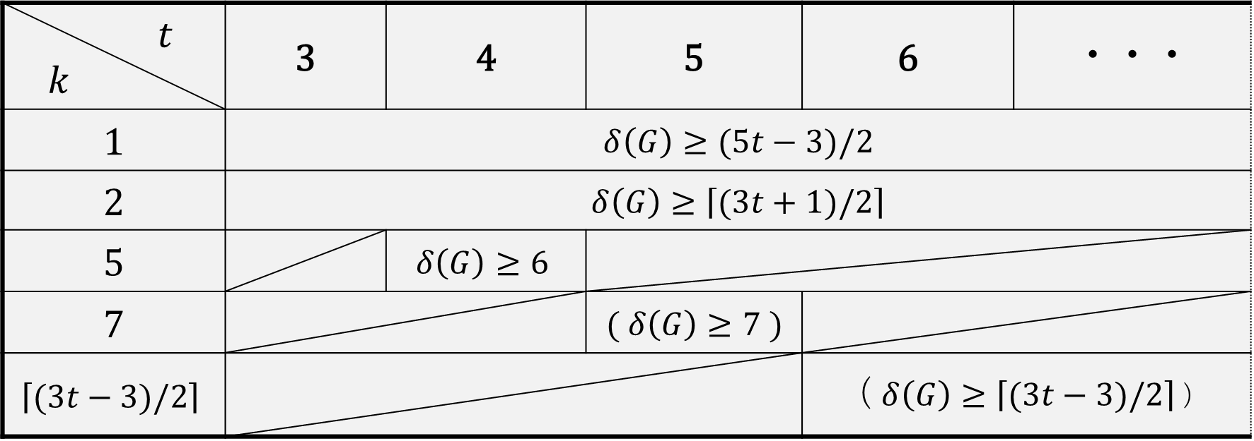

Minimum degree conditions to have a 4-factor in $k$-connected $K_{1,t}$-free graphs
$t$ $k$ | 3 | 4 | 5 | 6 | ・・・
1 | $δ\left(G\right)≥(5t−3)/2$
2 | $δ\left(G\right)≥\left\lceil (3t+1)/2\right\rceil$
5 |  | $$δ\left(G\right)≥6$$
7 |  |  | $$( δ\left(G\right)≥7 )$$
$$\left\lceil (3t−3)/2\right\rceil$$ |  |  |  | ( $δ\left(G\right)≥\left\lceil (3t−3)/2\right\rceil$ )
(Egawa and Kotani, 2011)
Egawa and Kotani, 2013 and 2014
4-factor’s case has been completed.
All minimum degree conditions are sharp.
4-factor’s case is similar to 2-factor’s case.

Slide 11
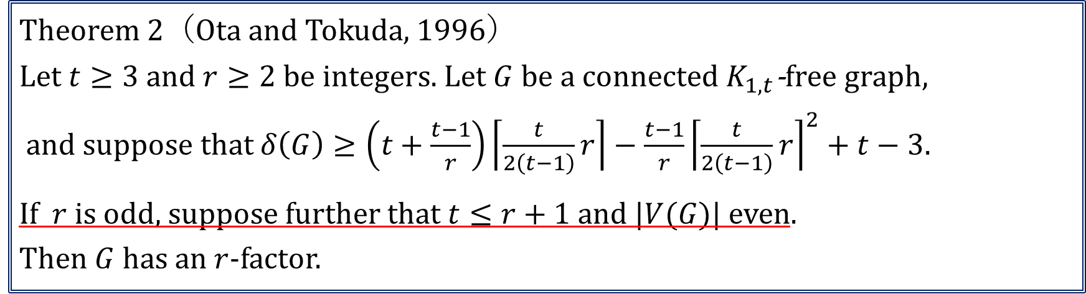
3-factors in $K_{1,t}$-free graphs
Theorem 2（Ota and Tokuda, 1996）
Let $t≥3$and $r≥2$ be integers. Let $G$ be a connected $K_{1,t}$-free graph,
and suppose that $δ\left(G\right)≥\left(t+\frac{t−1}{r}\right)\left\lceil \frac{t}{2\left(t−1\right)}r\right\rceil −\frac{t−1}{r}{\left\lceil \frac{t}{2\left(t−1\right)}r\right\rceil }^{2}+t−3.$
If $r$ is odd, suppose further that $t≤r+1$ and |$V(G)$| even.
Then $G$ has an $r$-factor.
We have to suppose further the conditions if $r$ is odd.
For $t≥r+2$, we cannot get minimum degree condition from Thm.2.

Slide 12
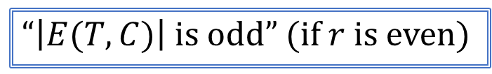
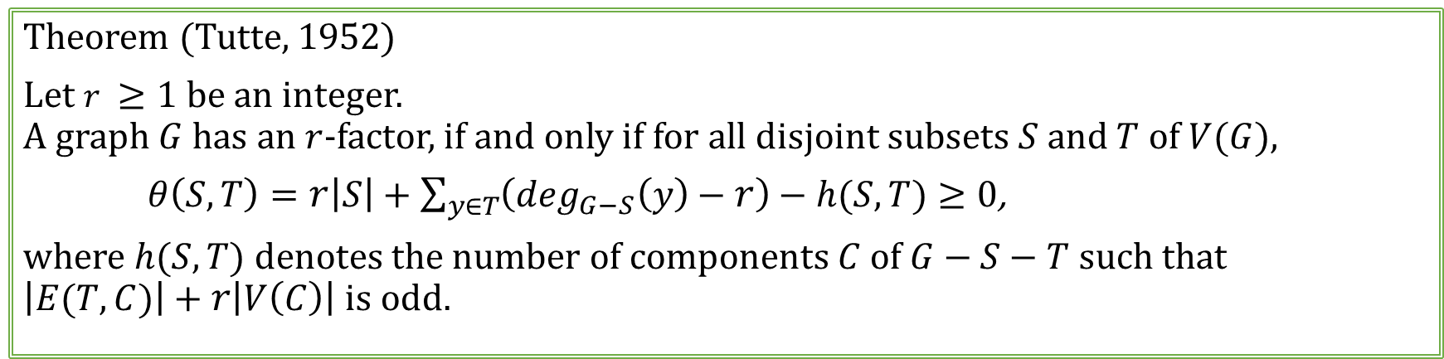
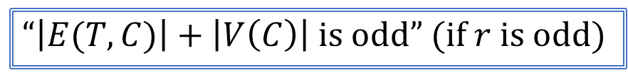
Tutte’s theorem
Theorem (Tutte, 1952)
Let $r ≥1$ be an integer.
A graph $G$ has an $r$-factor, if and only if for all disjoint subsets $S$ and $T$ of $V(G)$,
$θ\left(S,T\right)=r\left|S\right|+\sum_{y∈T}{\left(\deg_{G−S}\left(y\right)−r\right)−h(S,T)}≥0$,
where $h(S,T)$ denotes the number of components $C$ of $G−S−T$ such that
$\left|E(T,C)\right|+r\left|V\left(C\right)\right|$ is odd.
“$\left|E(T,C)\right|$ is odd” (if $r$ is even)
“$\left|E(T,C)\right|+\left|V\left(C\right)\right|$ is odd” (if $r$ is odd)
The above part differs between even and odd.

Slide 13




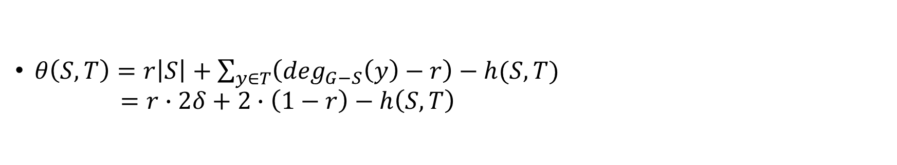

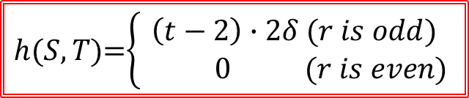





“$t≤r+1$ if $r$ is odd” cannot be dropped ①
$t≥3,r≥2, δ≥1$: integers
$$G_{3}$$
$$T$$
: $K_{2} ( ×1 )$
$$S$$
: $K_{2δ} ( ×1 )$
…
…
…
…
: $K_{2δ+1} ( ×2δ\left(t−2\right) )$
…
…
…
…
$$t−2$$
$$t−2$$
$$t−2$$
$G_{3}$ is a conn. $K_{1,t}$-free graph of even order with $δ\left(G\right)=2δ$.
By applying Tutte’s theorem, we see that $G_{3}$ has no $r$-factor
for any odd integer $r$ with $t≥r+2$.
$θ\left(S,T\right)=r\left|S\right|+\sum_{y∈T}{\left(\deg_{G−S}\left(y\right)−r\right)−h(S,T)}$
$=r∙2δ+2∙\left(1−r\right)−h\left(S,T\right)$
$h(S,T)$=$\left\{\begin{aligned}\left(t−2\right)∙2δ (r is odd) \\ 0 (r is even)\end{aligned}\right.$

Slide 14
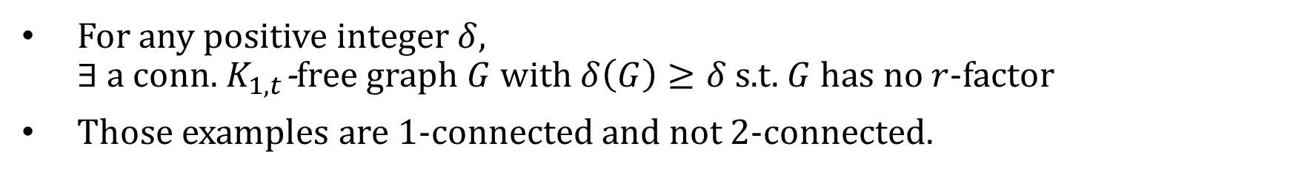

“$t≤r+1$ if $r$ is odd” cannot be dropped ②
$δ≥1$: integer
$$G_{3}$$
: $K_{2} ( ×1 )$
…
: $K_{2δ} ( ×1 )$
…
…
…
: $K_{2δ+1} ( ×2δ\left(t−2\right) )$
…
…
…
…
$$t−2$$
$$t−2$$
$$t−2$$
For any positive integer $δ$,
$∃$ a conn. $K_{1,t}$-free graph $G$ with $δ\left(G\right)≥δ$ s.t. $G$ has no $r$-factor
Those examples are 1-connected and not 2-connected.
Can we drop the condition “$t≤r+1$” by assuming larger connectivity?

Slide 15
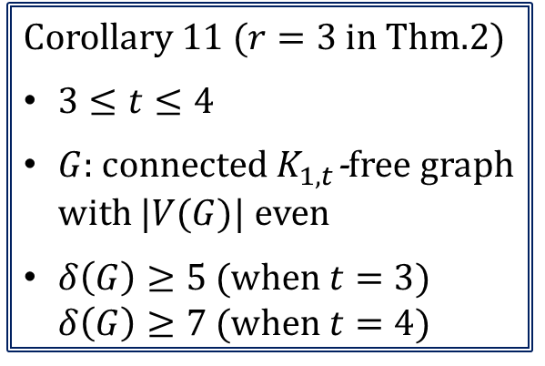
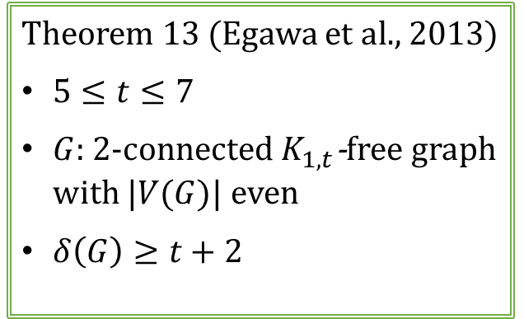
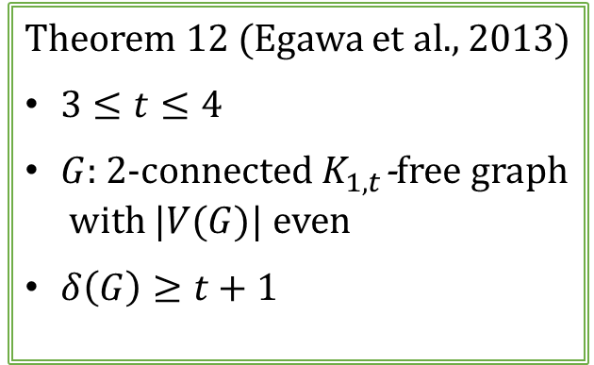
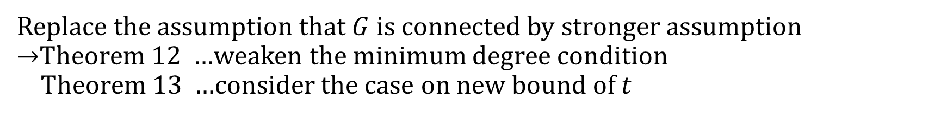
Sufficient conditions to have a 3-factor in $K_{1,t}$-free graphs
Corollary 11 ($r=3$ in Thm.2)
$3≤t≤4$
$G$: connected $K_{1,t}$-free graph with |$V(G)$| even
$δ\left(G\right)≥5$ (when $t=3$)
$δ\left(G\right)≥7$ (when $t=4$)
Theorem 12 (Egawa et al., 2013)
$3≤t≤4$
$G$: 2-connected $K_{1,t}$-free graph
with |$V(G)$| even
$δ\left(G\right)≥t+1$
Theorem 13 (Egawa et al., 2013)
$5≤t≤7$
$G$: 2-connected $K_{1,t}$-free graph
with |$V(G)$| even
$δ\left(G\right)≥t+2$
Replace the assumption that $G$ is connected by stronger assumption
→Theorem 12 …weaken the minimum degree condition
Theorem 13 …consider the case on new bound of $t$

Slide 16
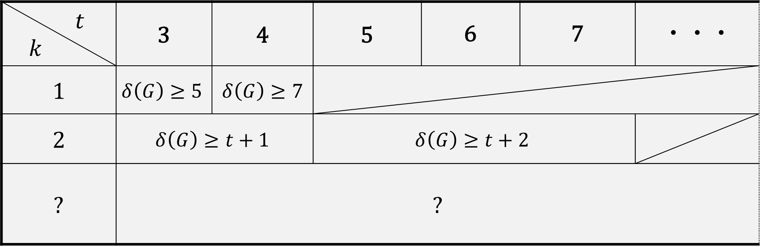

Minimum degree conditions to have a 3-factor in $k$-connected $K_{1,t}$-free graphs
$t$ $k$ | 3 | 4 | 5 | 6 | 7 | ・・・
1 | $$δ\left(G\right)≥5$$ | $$δ\left(G\right)≥7$$
2 | $$δ\left(G\right)≥t+1$$ |  | $$δ\left(G\right)≥t+2$$
? | ?
(This part had not been obtained before.)

Slide 17
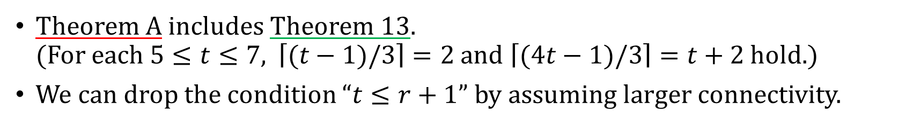
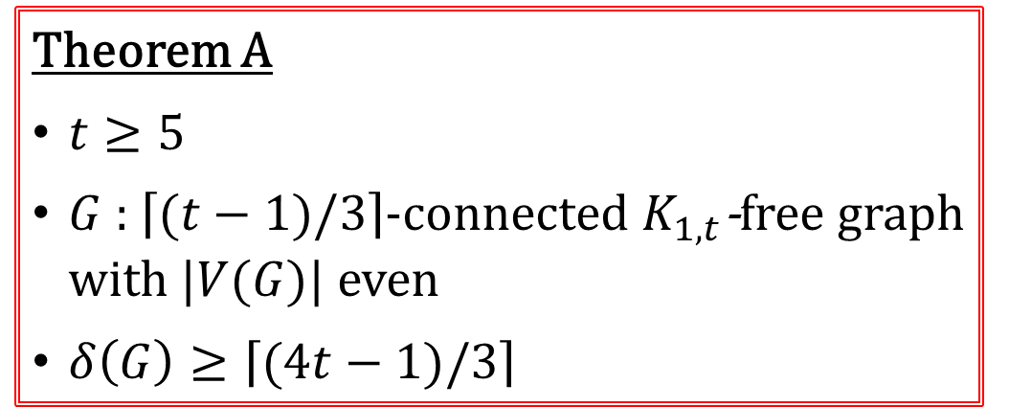
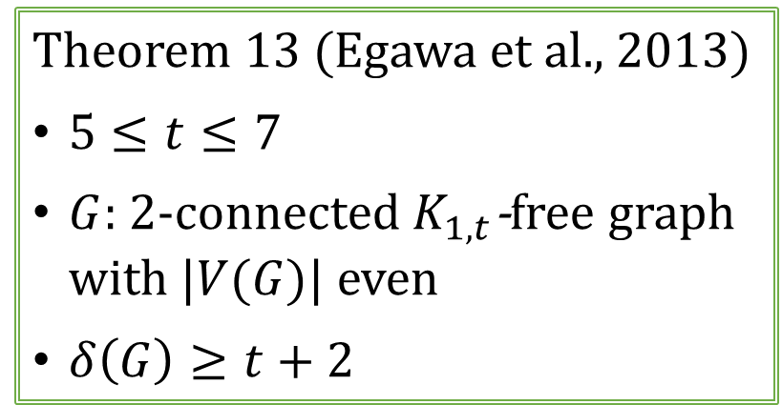
Main Results (Theorem A)
Theorem 13 (Egawa et al., 2013)
$5≤t≤7$
$G$: 2-connected $K_{1,t}$-free graph
with |$V(G)$| even
$δ\left(G\right)≥t+2$
Theorem A
$t≥5$
$G$ : $\left\lceil (t−1)/3\right\rceil$-connected $K_{1,t}$-free graph
with |$V(G)$| even
$δ\left(G\right)≥\left\lceil (4t−1)/3\right\rceil$
Then $G$ has a 3-factor.
Theorem A includes Theorem 13.
(For each $5≤t≤7$, $\left\lceil (t−1)/3\right\rceil =2$ and $\left\lceil (4t−1)/3\right\rceil =t+2$ hold.)
We can drop the condition “$t≤r+1$” by assuming larger connectivity.

Slide 18
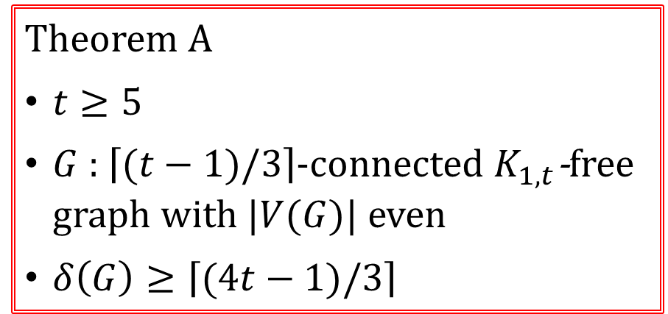
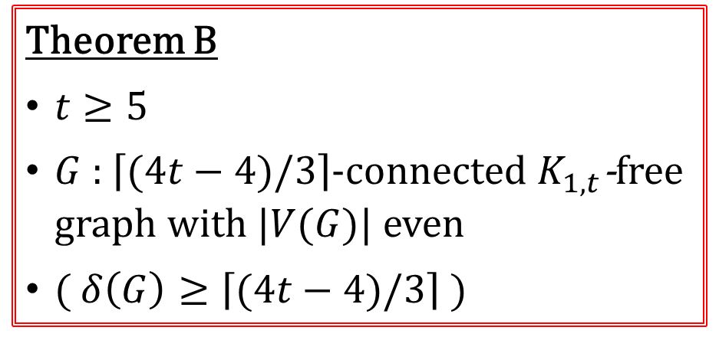
Main Results (Theorem B)
Theorem A
$t≥5$
$G$ : $\left\lceil (t−1)/3\right\rceil$-connected $K_{1,t}$-free
graph with |$V(G)$| even
$δ\left(G\right)≥\left\lceil (4t−1)/3\right\rceil$
Theorem B
$t≥5$
$G$ : $\left\lceil (4t−4)/3\right\rceil$-connected $K_{1,t}$-free graph with |$V(G)$| even
( $δ\left(G\right)≥\left\lceil (4t−4)/3\right\rceil$ )
Then $G$ has a 3-factor.
weaken the minimum degree condition in Thm.A (just 1, though)

Slide 19
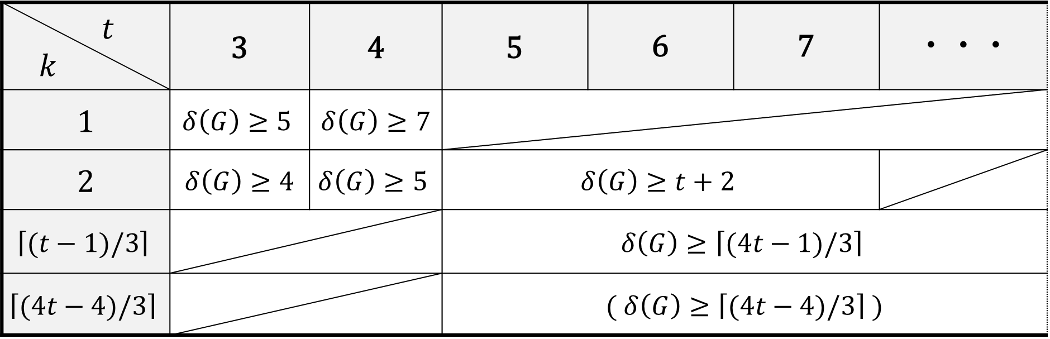
Minimum degree conditions to have a 3-factor in $k$-connected $K_{1,t}$-free graphs
$t$ $k$ | 3 | 4 | 5 | 6 | 7 | ・・・
1 | $$δ\left(G\right)≥5$$ | $$δ\left(G\right)≥7$$
2 | $δ\left(G\right)≥4$ | $$δ\left(G\right)≥5$$ | $$δ\left(G\right)≥t+2$$
$$\left\lceil (t−1)/3\right\rceil$$ |  |  | $$δ\left(G\right)≥\left\lceil (4t−1)/3\right\rceil$$
$$\left\lceil (4t−4)/3\right\rceil$$ |  |  | ( $δ\left(G\right)≥\left\lceil (4t−4)/3\right\rceil$ )
The case of a 3-factor has been completed.

Slide 20
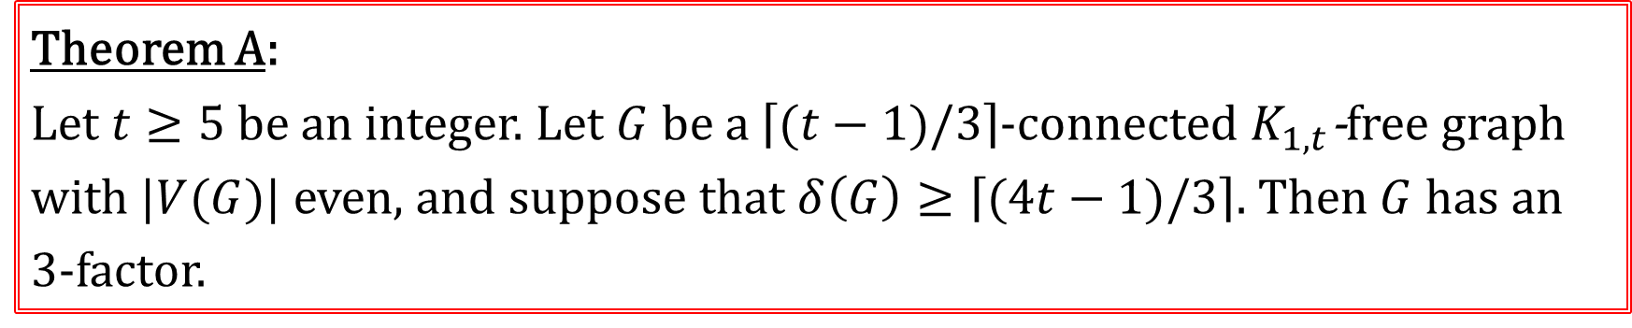
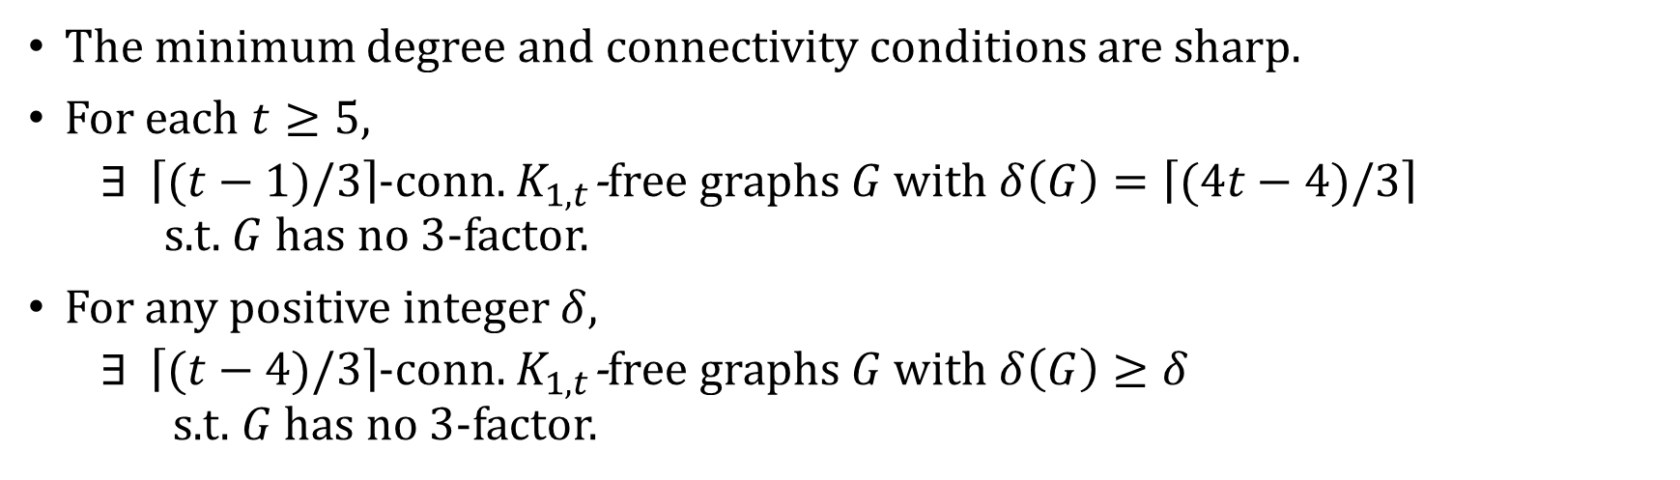
Sharpness of Theorem A
Theorem A:
Let $t≥5$ be an integer. Let $G$ be a $\left\lceil (t−1)/3\right\rceil$-connected $K_{1,t}$-free graph
with |$V(G)$| even, and suppose that $δ\left(G\right)≥\left\lceil (4t−1)/3\right\rceil$. Then $G$ has an 3-factor.
The minimum degree and connectivity conditions are sharp.
For each $t≥5$,
  $∃$ $\left\lceil (t−1)/3\right\rceil$-conn. $K_{1,t}$-free graphs $G$ with $δ\left(G\right)=\left\lceil (4t−4)/3\right\rceil$
  s.t. $G$ has no 3-factor.
For any positive integer $δ$,
  $∃$ $\left\lceil (t−4)/3\right\rceil$-conn. $K_{1,t}$-free graphs $G$ with $δ\left(G\right)≥δ$
  s.t. $G$ has no 3-factor.

Slide 21
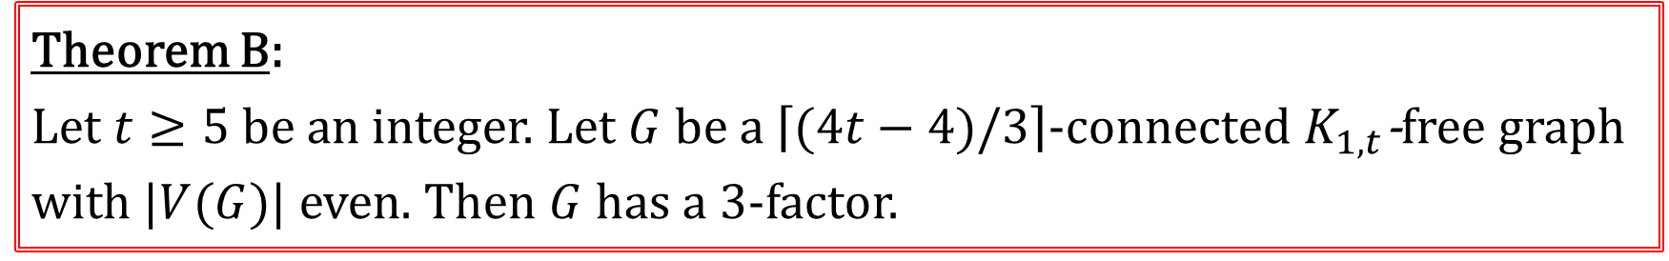
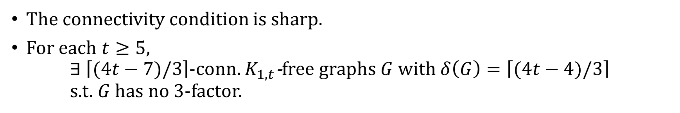
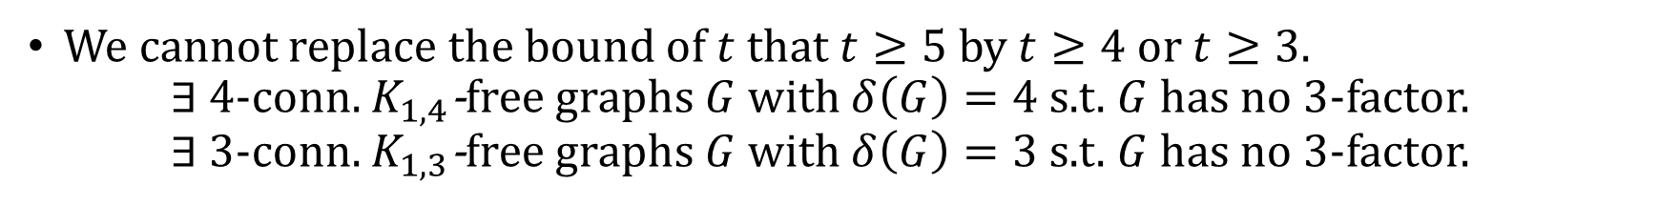
Sharpness of Theorem B
Theorem B:
Let $t≥5$ be an integer. Let $G$ be a $\left\lceil (4t−4)/3\right\rceil$-connected $K_{1,t}$-free graph
with |$V(G)$| even. Then $G$ has a 3-factor.
The connectivity condition is sharp.
For each $t≥5$,
$∃ \left\lceil (4t−7)/3\right\rceil$-conn. $K_{1,t}$-free graphs $G$ with $δ\left(G\right)=\left\lceil (4t−4)/3\right\rceil$
s.t. $G$ has no 3-factor.
We cannot replace the bound of $t$ that $t≥5$ by $t≥4$ or $t≥3$.
$∃$ 4-conn. $K_{1,4}$-free graphs $G$ with $δ\left(G\right)=4$ s.t. $G$ has no 3-factor.
$∃$ 3-conn. $K_{1,3}$-free graphs $G$ with $δ\left(G\right)=3$ s.t. $G$ has no 3-factor.

Slide 22



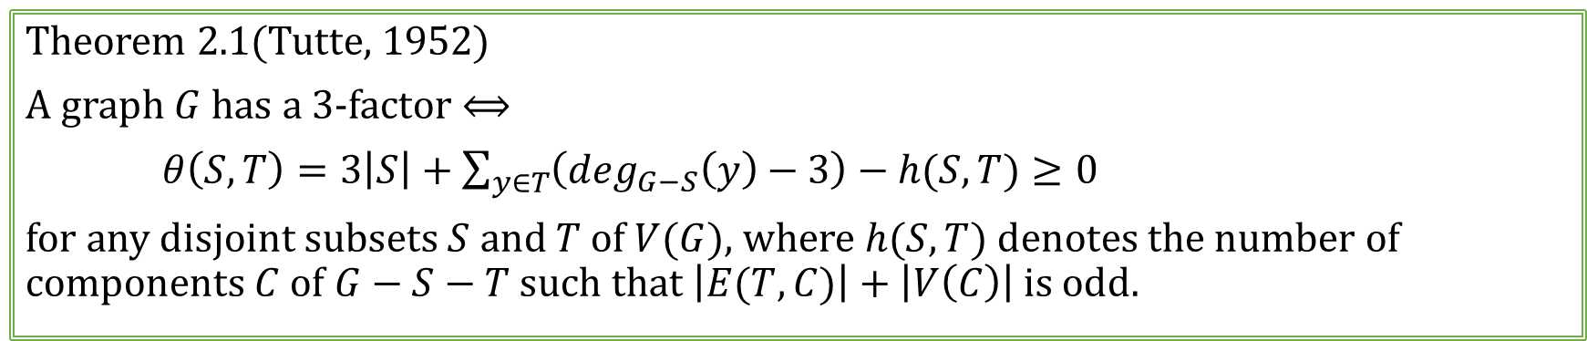



Outline of Proof ①
Theorem 2.1(Tutte, 1952)
A graph $G$ has a 3-factor $⟺$
$θ\left(S,T\right)=3\left|S\right|+\sum_{y∈T}{\left(\deg_{G−S}\left(y\right)−3\right)−h(S,T)}≥0$
for any disjoint subsets $S$ and $T$ of $V(G)$, where $h(S,T)$ denotes the number of components $C$ of $G−S−T$ such that $\left|E(T,C)\right|+\left|V\left(C\right)\right|$ is odd.
$$S$$
$$T$$
・・・・・・・・・
$$C_{1}$$
$$C_{2}$$
$$C_{k}$$
$$G−S−T$$

Slide 23
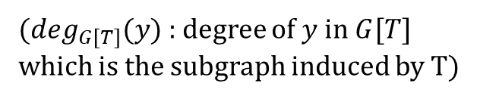
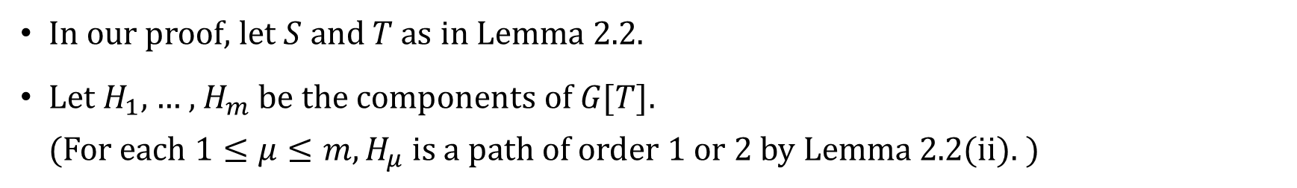

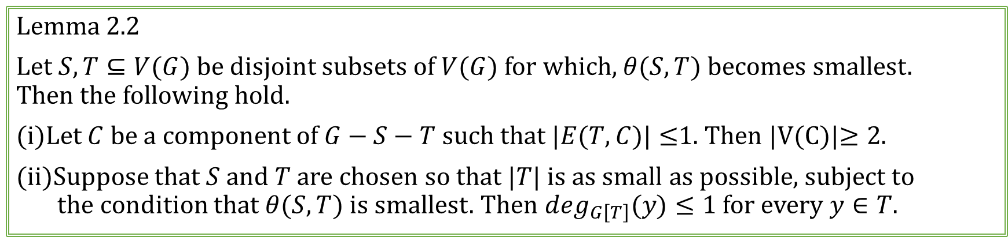



Outline of Proof ②
Lemma 2.2
Let $S, T⊆V(G)$ be disjoint subsets of $V(G)$ for which, $θ(S,T)$ becomes smallest.
Then the following hold.
(i)Let $C$ be a component of $G−S−T$ such that $|E(T,C)|≤$1. Then |V(C)|$≥2$.
(ii)Suppose that $S$ and $T$ are chosen so that $|T|$ is as small as possible, subject to
the condition that $θ(S,T)$ is smallest. Then $\deg_{G\left[T\right]}(y)≤1$ for every $y∈T$.
In our proof, let $S$ and $T$ as in Lemma 2.2.
Let $H_{1}$, … , $H_{m}$ be the components of $G[T]$.
(For each $1≤μ≤m, H_{μ}$ is a path of order 1 or 2 by Lemma 2.2(ii). )
($\deg_{G\left[T\right]}(y)$: degree of $y$ in $G[T]$
which is the subgraph induced by T)
$$H_{1}$$
$$H_{2}$$
$$H_{m}$$
The structure of components became a little clear !
…
$$G[T]$$

Slide 24



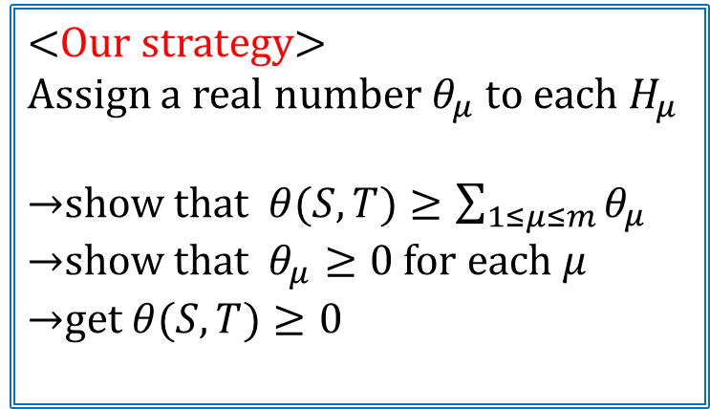







Outline of Proof ③
$$S$$
$$T$$
<Our strategy>
Assign a real number $θ_{μ}$ to each $H_{μ}$
→show that $θ(S,T)≥\sum_{1≤μ≤m}{θ_{μ}}$
→show that $θ_{μ}≥0$ for each $μ$
→get $θ(S,T)≥0$
$$H_{1}$$
$$H_{2}$$
$$H_{m}$$
…
・・・
・・・
$$C_{1}$$
$$C_{a}$$
$$C_{a+1}$$
$$C_{k}$$
$$G−S−T$$

Slide 25











Outline of Proof ④ (the part applying $K_{1,t}$-free condition)
The structure of components $G−S−T$ and $G\left[T\right]$ became a little clear by Lemma 2.2 .
The existence of some edges joining $x∈S$ and each components is guaranteed
by connectivity condition.
For each $x∈S$, the number of independent vertices in $N(x)$ is no more than $t−1$.
$$S$$
$T$ ($G\left[T\right]$)
$$H_{1}$$
$$H_{2}$$
$$H_{m}$$
$$x$$
…
…
…
…
…
・・・
・・・
$$C_{1}$$
$$C_{a}$$
$$C_{a+1}$$
$$C_{k}$$
$$G−S−T$$

Slide 26
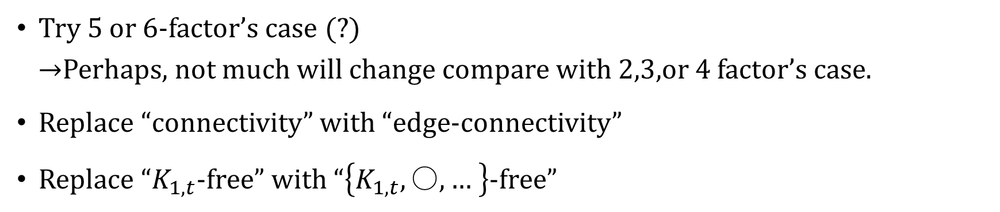
Future Work
Try 5 or 6-factor’s case (?)
→Perhaps, not much will change compare with 2,3,or 4 factor’s case.
Replace “connectivity” with “edge-connectivity”
Replace “$K_{1,t}$-free” with “$\left\{K_{1,t}, 〇,… \right\}$-free”

Slide 27
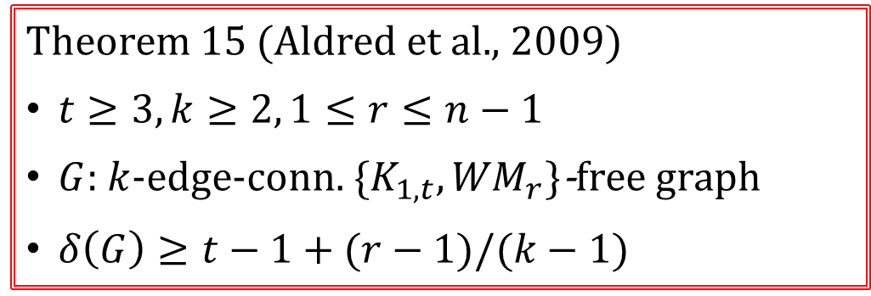

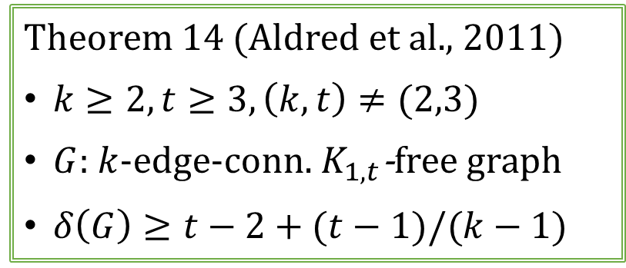
Edge connectivity and $\left\{K_{1,t},{WM}_{r}\right\}$-free condition
Theorem 14 (Aldred et al., 2011)
$k≥2, t≥3, \left(k,t\right)≠(2,3)$
$G$: $k$-edge-conn. $K_{1,t}$-free graph
$δ\left(G\right)≥t−2+(t−1)/(k−1)$
Theorem 15 (Aldred et al., 2009)
$t≥3, k≥2, 1≤r≤n−1$
$G$: $k$-edge-conn. $\{K_{1,t}, {WM}_{r}\}$-free graph
$δ\left(G\right)≥t−1+(r−1)/(k−1)$
Then $G$ has a 2-factor.
${WM}_{r}$ : $K_{1}+rK_{2}$
…
…

Slide 28
Thank you for your attention

Slide 30
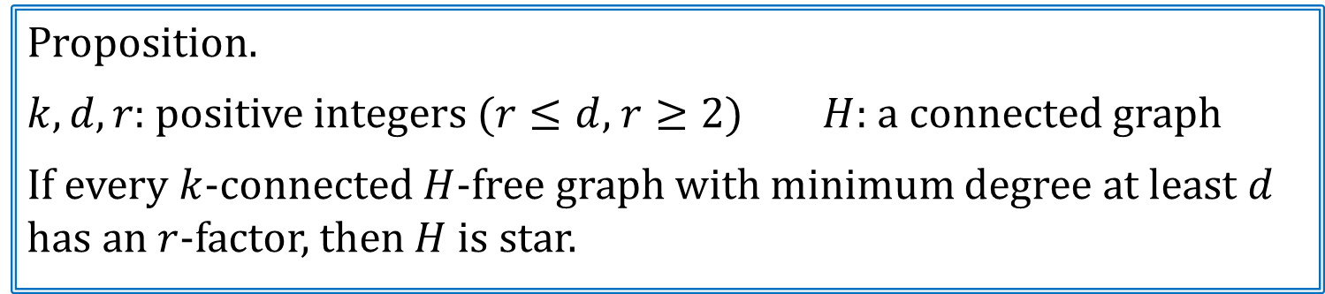
Star-free condition
Star-free condition has been popular to examine sufficient conditions for a graph to have a certain factor.
If we are only forbidding a single subgraph, then it must be a star.
Proposition.
$k, d, r$: positive integers ($r≤d$, $r≥2$) $H$: a connected graph
If every $k$-connected $H$-free graph with minimum degree at least $d$
has an $r$-factor, then $H$ is star.
If we want to guarantee the existence of a regular factor by assuming connectivity and minimum degree conditions, we have to assume that the graph is star-free.

Slide 31
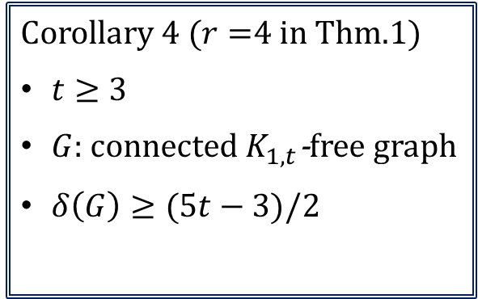
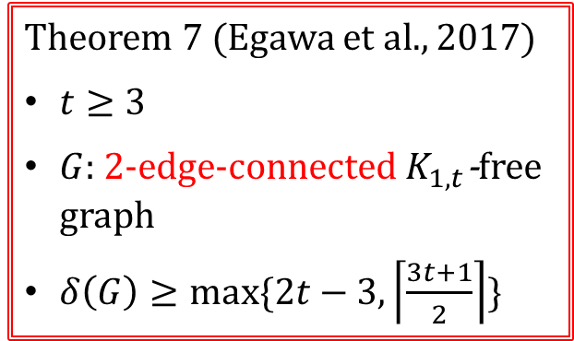

Assumptions such that $G$ has a 4-factor in star-free graphs
Corollary 4 ($r=$4 in Thm.1)
$t≥3$
$G$: connected $K_{1,t}$-free graph
$δ\left(G\right)≥(5t−3)/2$
Theorem 7 (Egawa et al., 2017)
$t≥3$
$G$: 2-edge-connected $K_{1,t}$-free graph
$δ\left(G\right)≥max⁡\{2t−3,\left\lceil \frac{3t+1}{2}\right\rceil \}$
Theorem 5 (Egawa et al., 2011)
$t≥3$
$G$: 2-connected $K_{1,t}$-free graph
$δ\left(G\right)≥\left\lceil (3t+1)/2\right\rceil$
Then $G$ has a 4-factor.

Slide 32





Sufficient conditions to have a 4-factor in $K_{1,t}$-free graphs
Corollary 6 ($r=2$ in Thm.2)
$t≥3$
$G$: connected $K_{1,t}$-free graph
$δ\left(G\right)≥(5t−3)/2$
Theorem 7 (Egawa et al., 2011)
$t≥3$
$G$: 2-connected $K_{1,t}$-free graph
$δ\left(G\right)≥\left\lceil (3t+1)/2\right\rceil$
Theorem 8 (Egawa et al., 2014)
$G$: 5-connected $K_{1,4}$-free graph
$δ\left(G\right)≥6$
Theorem 10 (Egawa et al., 2013)
$t≥6$
$G$: $\left\lceil (3t−3)/2\right\rceil$-connected $K_{1,t}$-free graph
( $δ\left(G\right)≥\left\lceil (3t−3)/2\right\rceil$)
Theorem 9 (Egawa et al., 2014)
$G$: 7-connected $K_{1,5}$-free graph
( $δ\left(G\right)≥7$)

Slide 33


Proof of Theorem B ①
Theorem 2.1 (Tutte, 1952)
Let $r ≥1$ be an integer and $G$ be a general graph.
Then $G$ has an $k$-factor, if and only if for all disjoint subsets $S$ and $T$ of $V(G)$,
$θ\left(S,T\right)=r\left|S\right|+\sum_{y∈T}{\left(\deg_{G−S}\left(y\right)−r\right)−h(S,T)}≥0$,
where $h(S,T)$ denotes the number of components $C$ of $G−S−T$
such that $\left|E(T,C)\right|+r\left|V\left(C\right)\right|$ is odd.
Lemma 2.2 ($r=3$ in Thm. 2.1)
A graph $G$ has an 3-factor, if and only if for any disjoint subsets $S$ and $T$ of $V(G)$,
$θ\left(S,T\right)=3\left|S\right|+\sum_{y∈T}{\left(\deg_{G−S}\left(y\right)−3\right)−h(S,T)}≥0$,
where $h(S,T)$ denotes the number of components $C$ of $G−S−T$
such that $\left|E(T,C)\right|+\left|V\left(C\right)\right|$ is odd.
We use Theorem 2.1 which was proved by Tutte for the existence of $r$-factor.

Slide 34

Proof of Theorem B ①
Theorem 2.1 (Tutte, 1952)
Let $r ≥1$ be an integer and $G$ be a general graph.
Then $G$ has an $k$-factor, if and only if for all disjoint subsets $S$ and $T$ of $V(G)$,
$θ\left(S,T\right)=r\left|S\right|+\sum_{y∈T}{\left(\deg_{G−S}\left(y\right)−r\right)−h(S,T)}≥0$,
where $h(S,T)$ denotes the number of components $C$ of $G−S−T$ such that
$\left|E(T,C)\right|+r\left|V\left(C\right)\right|$ is odd.
Actually, the theorem have been used for the problems of $r$-factors in $K_{1,t}$-free graphs.
We use Theorem 2.1 which was proved by Tutte for the existence of $r$-factor.

Slide 35

Star-free condition
Star-free condition has been popular to examine sufficient conditions for a graph to have a certain factor.
We concentrate on the existence of regular factors in terms of star-free condition although there are many different conditions
If we are only forbidding a single subgraph for regular factors, then it must be a star.
For star-free graphs, we can grantee the existence of a regular by assuming connectivity and minimum degree conditions.
Proposition.
$k, d, r$: positive integers ($r≤d$, $r≥2$) $H$: a connected graph
If every $k$-connected $H$-free graph with minimum degree at least $d$
has an $r$-factor, then $H$ is star.
There is no gap between connectivity and minimum degree conditions
which we have to assume.

Slide 36

$r(≥2)$-factors in $K_{1,t}$-free graphs
We can guarantee the existence of a $r(≥2)$-factor by imposing the following minimum degree condition, regardless of its connectivity.
Theorem 2（Ota and Tokuda, 1996）
Let $t≥3$and $r≥2$ be integers. Let $G$ be a connected $K_{1,t}$-free graph,
and suppose that $δ\left(G\right)≥\left(t+\frac{t−1}{r}\right)\left\lceil \frac{t}{2\left(t−1\right)}r\right\rceil −\frac{t−1}{r}{\left\lceil \frac{t}{2\left(t−1\right)}r\right\rceil }^{2}+t−3.$
If $r$ is odd, suppose further that $t≤r+1$ and |$V(G)$| even.
Then $G$ has an $r$-factor.
Their minimum degree condition is sharp.

